Slide 1


Realization of a mobile application ‘Health Maintaining’
Advisor :
Mr Mourad Gridach
Groupe Members :
Mr Mouaad Sadik
& Mlle Mariam Sebbar
& Mlle Sana Er-Rachedy
Jury Members :
Mr Mourad Gridach
Mr Driss Kiouach
Notes:
SANA
Hello everybody before starting our presentation we would like to thank our advisor Mr.Gridach and the jury member Mr.Kiouach for assisting to our SOUTENANCE of final year project and accepting to evaluate our work .

Slide 2
PLAN :
INTRODUCTION
Problematic
1
2
Project Analysis
Demo
3
CONCLUSION
4
5
Notes:
MOUAD

Slide 3

INTRODUCTION
Notes:
MARIAM
Artificial intelligence (AI) is a branch of computer science that aims to create intelligent and smart machines that
mimics human cognition . AI has been used to develop and advance numerous fields and industries, including finance,
education, transportation and especially in healthcare that's why we choosed to work on the
project "Realization of a mobile application ‘Health Maintaining’ ".

Slide 4
Problematic

Slide 5

Why Healthcare ?
Notes:
SANA
If your health fails, it can overshadow everything else that’s going on in your
life. From relatively minor health issues such as aches and pains, lethargy, and
indigestion to major health problems that can threaten your existence, health can
really affect happiness and stress levels. Making a commitment to taking on
healthier habits can have a far-reaching payoff : you’ll feel better in everything you
do.

Slide 6

Why image Classification ?
Notes:
MOUAD
we know that you are wonderingg now :why we used image classification instead of
just using the name of fruits given by the user?
First of all we choosed work on image classification cause it would be so helpful
especially when you find in your refrigerator an unknown fruit.
Besides it Makes the application more entertaining and helps the user to enjoy his diet.

Slide 7
Project Analysis

Slide 8
The Model
1
Prepare data
Build the Model
2
Evaluate accuracy
3
Notes:
In order to develop our application we used a sequential model ,Exactly the Keras library with a tensorflow backend..
we followed many steps..

Slide 9
1
Prepare data
Importing dataset
Specifying output classes (53)
Resizing images
Creating training images (Features)
Creating testing images (Labels)
Deviding labels and features by 255
Notes:
MARIAM
STEP 1: IMPORT DATA
1) we imported our dataset of Fruits from Kaggle.com, which are divised into two
folders , training data and testing data.
2)
3)Resizing images from 100/100 to 60*60
4) features contains array of images
5) labels contains number of classes
6) we scale these values to a range of 0 to 1 before feeding
to the neural network model.

Slide 10
2
Build the Model
Set up the layers
Compile the model
Train the model
Notes:
SANA
STEP 2: BUILDING MODEL
To build our model we used convolutional neural networks and we followed these 3 steps .

Slide 11
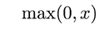
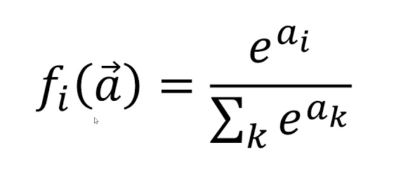
2.1
64
4 Layers
32
Flatten
53
Notes:
1)Set up the layers
------The first one in this network provide the keyword argument
input_shape (60x60x3).
It is a mathematical
operation that takes two inputs such as image matrix and a filter or
kernel, it has 64 nodes (or neurons).
Right after the convolution step there is RelU activation function ,
replaces all negative pixel values in the feature map by zero.
-------The second layer is the same as the first but we don’t have an input
shape because it’s already montionned , it has 32 nodes .
--------The third layer transforms the format of the images from a 2d_array ,
to a 1d-array of 100352 pixels.
---------The last layer is densely-connected, or fully-connected, neural
layers, it is a 53 node softmax layer, this returns an array of 53
probability scores that sum to 1. Each node contains a score that
indicates the probability that the current image belongs to one of the
53 classes .

Slide 12
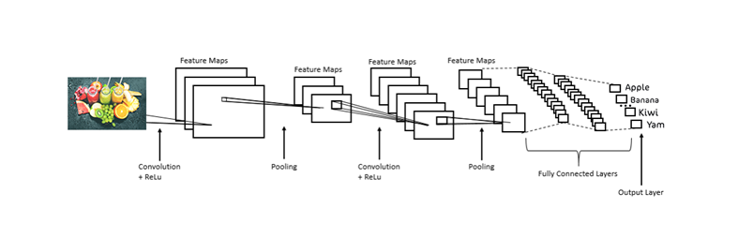
2.1
Complete CNN Architecture
Notes:
This picture shows a complete convolutional neural networks architecture

Slide 13
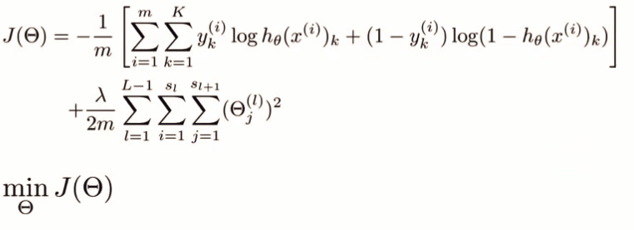

2.2
Loss function
Optimizer
Notes:
MOUAD
-AdamOptimizer:is an extension to stochastic gradient descent and to back propagate throught the network
after calculating the error rate and updating the weights.
-loss function: we used ’sparse_categorical_crossentropy’ because our classes are mutually exclusive: each sample
belongs exactly to one class.

Slide 14
2.3
Feed the training data to the model .
The model learn to associate images and labels.
We ask the model to make predictions about test set .
We verify that the predictions match the labels .
To start training, we call the “model.fit “ method.
Notes:
MARIAM

Slide 15
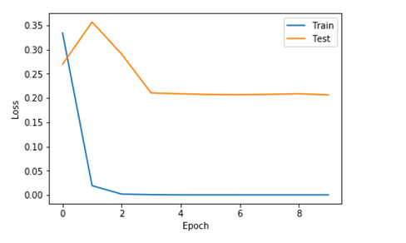
3
3
Evaluate accuracy
100%
96,50%
Plot of Model Loss on Training and Validation Datasets

Slide 16
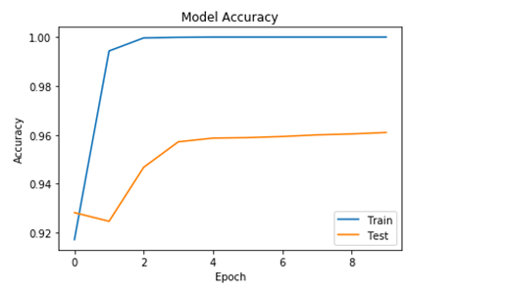
3
3
Plot of Model Accuracy on Train and Validation Datasets

Slide 17
The Application
Use Case Diagram
1
Sequence Diagram
2
Class Diagram
3
Notes:
SANA
After we finished training and testing for our model we implemented it in a mobile application . So ...

Slide 18
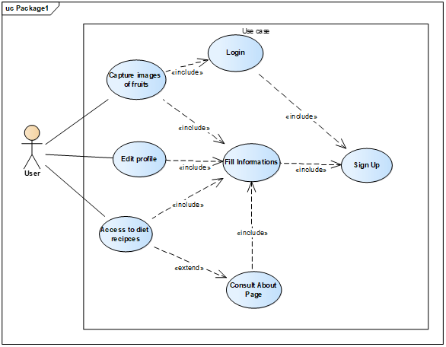
1

Slide 19
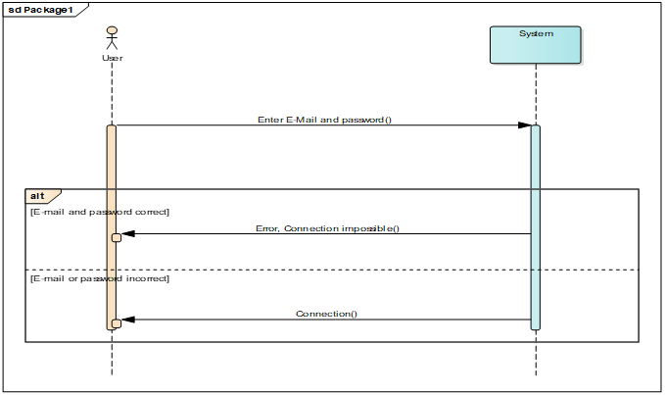
2
Notes:
MOUAD

Slide 20
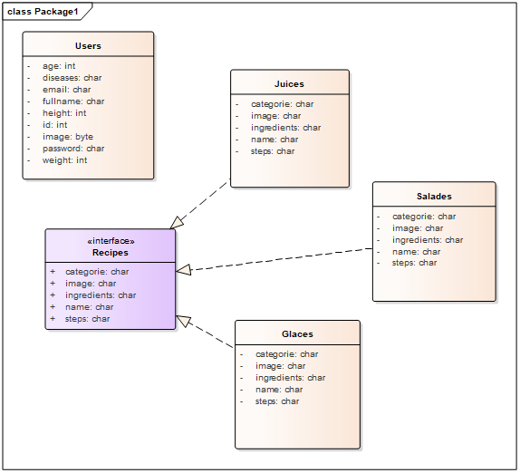
3
Notes:
MARIAM

Slide 21
Development tools
Softwares
1
Programming Languages
2
Frameworks
3

Slide 22








1
Softwares
Notes:
SANA

Slide 23


2
Programming Languages
Notes:
MOUAD

Slide 24






3
Frameworks
Notes:
MARIAM

Slide 25
Demo
Notes:
MOUAD

Slide 26
CONCLUSION
Notes:
َSANA:
By the end of this work we learned so many things :
how to work in a groupe ? How to build a model using tensorflow kireas ?
How to build a mobile aplication ? How to implement a model in it ?
MARIAM
but during all this process we faced a lot of problems ,
Tensorflow is a new language for us to discover,
we wanted to implement a vegetable model too but we couldnt find the dataset
we were obligated to finish our final project in a short time .. So we couldnt accomplish our plan .

Slide 27

Thank you
for
your Attention

